Slide 1
1900-1905 Planck – Einstein quantization
1911 Rutherford atomic model
1913 Bohr model apply quantization to the Rutherford model

Slide 2
The Limitation of Bohr’s model
Spectra of multi-electron atoms
The relative intensity of the spectral lines
Fine structure of the spectral lines
Anomalous Zeeman effect
“Monday, Wednesday, Friday use Classical rule，Tuesday, Thursday, Saturday use Quantum rule”

Slide 3
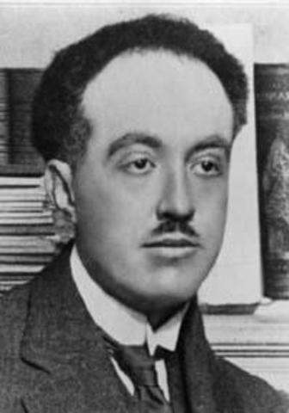
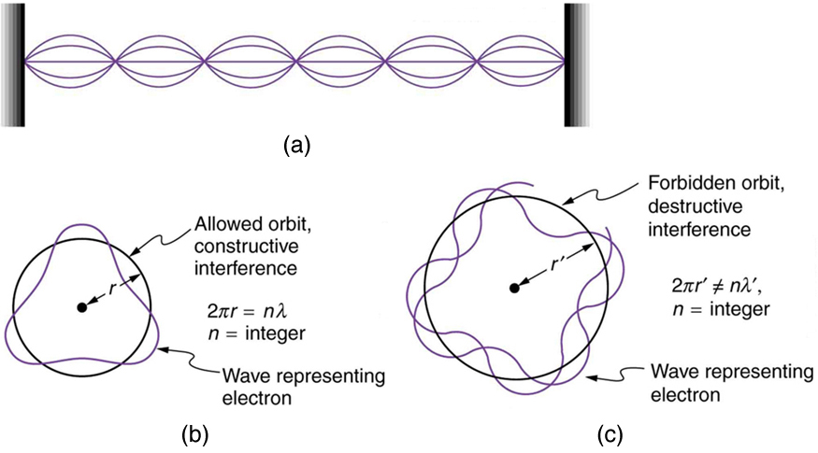
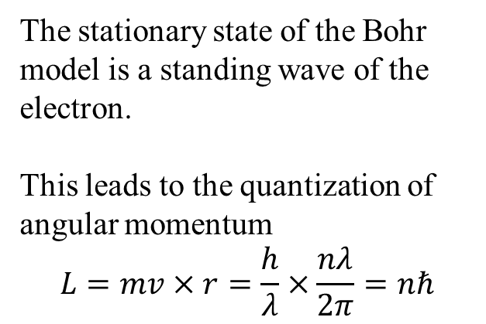
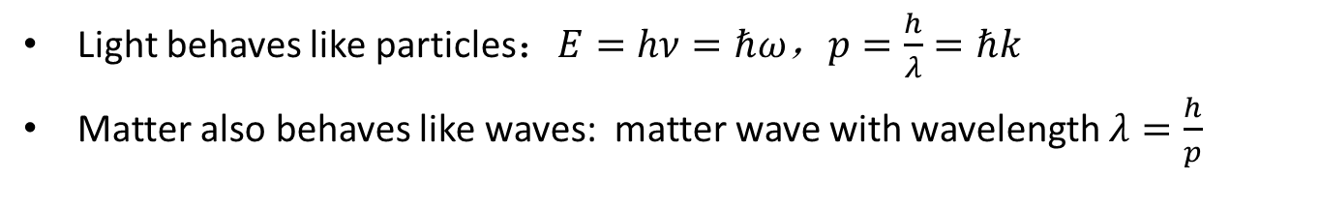

wave particle duality (1923)
Light behaves like particles：$E=hν=ℏω$，$p=\frac{h}{λ}=ℏk$
Matter also behaves like waves: matter wave with wavelength $λ=\frac{h}{p}$
$$l=n\frac{λ}{2}$$
de Broglie
The stationary state of the Bohr model is a standing wave of the electron.
This leads to the quantization of angular momentum
$$L=mv×r=\frac{h}{λ}×\frac{nλ}{2π}=nℏ$$

Slide 4
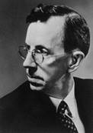
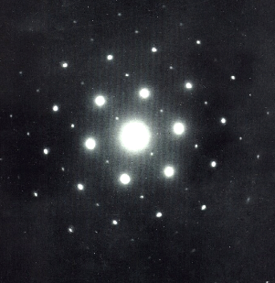
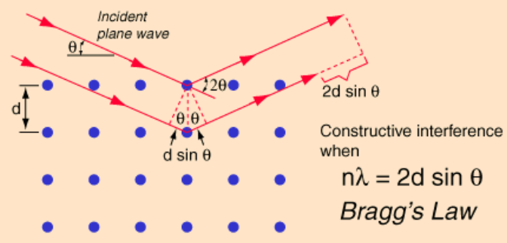
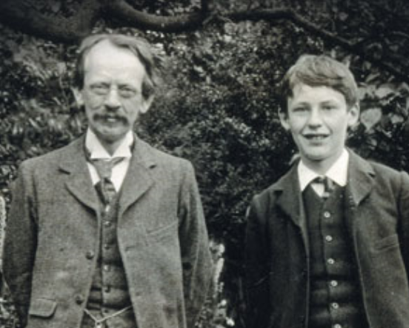

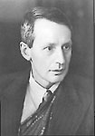
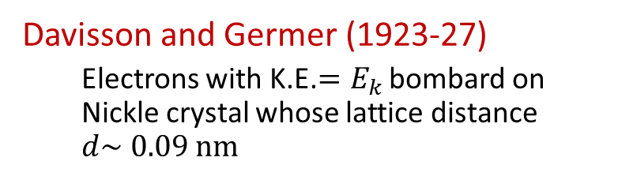
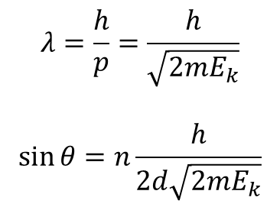
电子晶体衍射
Davisson and Germer (1923-27)
  Electrons with K.E.$=E_{k}$ bombard on Nickle crystal whose lattice distance $d\sim 0.09 nm$
$$λ=\frac{h}{p}=\frac{h}{\sqrt{2mE_{k}}}$$
$$\sin{θ}=n\frac{h}{2d\sqrt{2mE_{k}}}$$
Davisson
Electron diffraction of a Nickel monocrystal
汤姆森父子
Particle
Wave
G. P. Thomson (1926-27)
Shoot 10 KeV electron on a 0.1 micron thick gold foil (polycrystal of gold)
Electron diffraction of a gold polycrystal
Notes:
这个和α粒子打金箔有何区别？

